Slide 1
COCOT
Data Representation

Slide 2
Data refers to the symbols that represent people, events, things, and ideas.
Data can be a name, a number, the colors in a photograph, or the notes in a musical composition.
Data Representation refers to the form in which data is stored, processed, and transmitted.
Devices such as smartphones, iPods, and computers store data in digital formats that can be handled by electronic circuitry.

Slide 3
Number systems
Number Systems are techniques used to represent numbers in the computer system architecture.
Every value that you are saving or getting into/from computer has a defined number system.
Computer architecture supports the following number systems.
Decimal Number System
Binary Number System
Octal Number System
Hexadecimal Number System

Slide 4
1. Decimal Number System
Decimal Number System has only ten (10) digits from 0 to 9.
Every number represented with 0,1,2,3,4,5,6,7,8 and 9 is in this number system.
The base of decimal number system is 10 because it has only ten digits.
This number system is also referred to as base-10 Number System.
This is the number system that humans normally use.
The prefix deci means tenth, hence the name.

Slide 5
2. Binary Number System
Binary System has only two (2) digits: 0 and 1.
Every number (value) represented with 0 and 1 is this number system.
The base of binary number system is 2 because it has only two digits.
The 0s and 1s are referred to as bits (binary digits).
This number system is also referred to as base-2 Number System.
For example, the number 2 is represented as 10 in binary number system.
The prefix bi means two, hence the name.
It is fundamental to representing and manipulating data in computers and other digital systems.
Binary is used to store and process information at the lowest level in computing devices.

Slide 6
A group of eight bits is called a byte, and is usually abbreviated as uppercase B.
A group of 4 bits is called a nibble..

Slide 7
3. Octal Number System
Octal Number System has only eight (8) digits from 0 to 7.
Every number (value) represented with 0,1,2,3,4,5,6 and 7 is in this number system.
The base of the Octal number system is 8 because it has only eight digits.
This number system is also referred to as base-8 Number System.
For Example, the number 10 is represented as 12 in Octal Number System.
The word octal means eight, hence the name.

Slide 8
4. Hexadecimal Number System
Hexadecimal Number System has sixteen (16) alphanumeric values from 0 to 9 and A to F.
Every number represented with 0,1,2,3,4,5,6,7,8,9,A,B,C,D,E and F is in this number system.
The base of hexadecimal number system is 16 because it has sixteen alphanumeric values.
Here A is 10, B is 11, C is 12, D is 13, E is 14, and F is 15.
This number system is also referred to as base-16 Number System.
Hexadecimal is extensively used in programming, especially for representing memory addresses, color codes, and others.
It is also used in various technical fields like networking, cryptography, and assembly language programming.

Slide 9
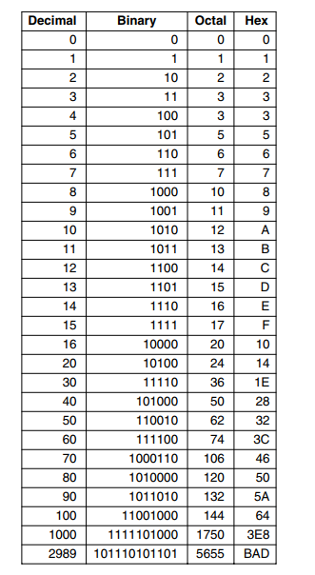
Table showing decimal numbers and their equivalents in Binary, Octal and Hexadecimal

Slide 10
Number System Conversion
Number Systems can be converted from one system to another and vice versa.
CONVERTING FROM BASE-10 TO OTHER BASES
To convert Number System from Decimal Number System to Any Other Number System is quite easy.
The following two steps can be followed to do this conversion:
Divide the Number (Decimal Number) by the base of the target base system (in which you want to convert the number to : Binary (2), Octal (8), Hexadecimal (16)).
Write the remainder in step 1 as a Least Significant Bit (LSB) to Step last as a Most Significant Bit (MSB).

Slide 11
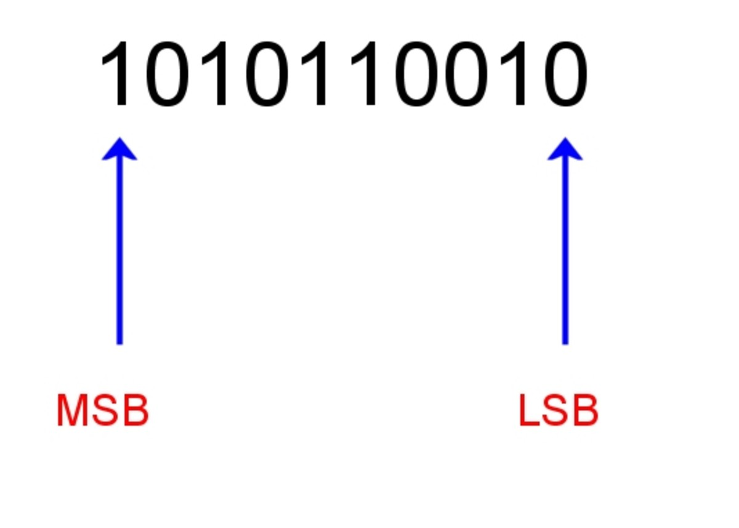

Slide 12
Example 1
Convert 8₁₀ to Binary number system (base 2).

Slide 13
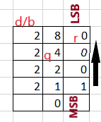
d/b = divider/base q = quotient r = remainder
Therefore 8₁₀ = 1000₂

Slide 14
Example 2
Convert (45)₁₀ to Binary Number System (base 2).

Slide 15
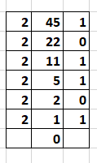
Therefore, 45₁₀ = 101101₂

Slide 16
Example 3
Convert 804₁₀ to Octal Number System (Base 8)

Slide 17
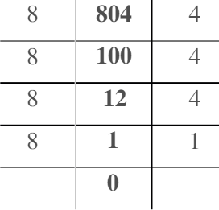
Therefore, 804₁₀ = 1444₈

Slide 18
Example 4
Convert 1600₁₀ to base-16 Number system

Slide 19
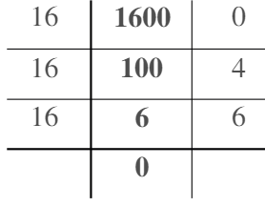
Therefore, 1600₁₀ = 640₁₆

Slide 20
Example 5
Convert 30₁₀ to base-16 (Hexadecimal)

Slide 21
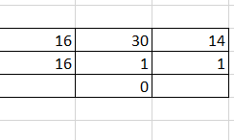
On remainder, we have 1 and 14, so, since 14 in base-16 is represented with E ,
therefore, 30₁₀ = 1E₁₆ .

Slide 22
CONVERTING FROM OTHER BASES TO BASE-10
To convert Number System from Any Other Number System to Decimal Number System is quite easy.
The following steps have to be followed:
Identify the base of the given number: Determine the base of the original number.
Evaluate the place value: Starting from the rightmost digit of the given number, assign a place value to each digit based on its position. The rightmost digit represents the base raised to the power of 0 , the next digit raised to power of 1 and so on.
Multiply each digit by its corresponding place value: Multiply each digit of the given number by its respective place value.
Sum up the results: Add up the products obtained from the previous step to get the decimal equivalent of the original number.

Slide 23
Example
Converting from base-2(Binary) to base-10 (decimal)
100100₂ = (2⁵x1) +(2⁴x0)+(2³x0)+(2²x1)+(2¹x0) + (2⁰x0)
= 32 + 0 + 0 + 4 + 0 +0
= 36₁₀

Slide 24
Converting from base-8(octal) to base-10 (decimal)
2040₈ = (8³x2)+(8²x0)+(8¹x4)+(8⁰x0)
= 1024+0+32+0
=1056₁₀

Slide 25
Converting from base-16(hexadecimal) to base-10 (decimal)
Convert 1E0D₁₆ to base-10
1E0D₁₆ = (16³x1) + (16²x E) + (16¹x0) + (16⁰xD)
= (4096 x 1 ) + (256 x 14) + (16 x 0) + (1 x 13)
= 4096 + 3584 + 13
= 7693₁₀

Slide 26
Converting from base 2 to base 8 and vice versa.
To convert from base-2 to base-8:
Group the binary digits: Starting from the rightmost digit of the binary number, group the digits into sets of three. If there are not enough digits to form a complete group of three, add leading zeros to the left.
Assign octal digits to each group: Replace each group of three binary digits with the corresponding octal digit.
Combine the octal digits: Write down the octal digits obtained from the previous step, left to right. This represents the equivalent base-8 number.

Slide 27
e.g
Convert 110111101₂ to base-8 (octal)
Answer:
Group the binary digits from the rightmost into sets of 3
110 111 101
Replace each group of three binary digits with the corresponding octal digit
110 -> 6, 111- >7, 101->5
Combine the octal digits
675
Therefore, 110111101₂ = 675₈
Try converting 10101010₂ to base-8

Slide 28
Converting base-8 number system back to base-2
Identify the digits: Starting from the leftmost digit of the base-8 number, identify each digit individually.
Convert each digit to binary: Convert each octal digit to its equivalent binary representation.
Combine the binary digits: Write down the binary digits obtained from the previous step, left to right. This represents the equivalent base-2 number.

Slide 29
E.g
Convert 543₈ to Binary Number System (base-2)
Identify the digits, i.e 5,4 and 3
Convert each digit to binary
5 -> 101, 4 -> 100, 3 -> 011
3. Combine binary digits
101100011₂
Try: Convert 254₈ to base-2

Slide 30
Converting from base 2 to base 16 and vice versa.
Converting from base-2 to base-16:
Group the binary digits: Starting from the rightmost digit of the binary number, group the digits into sets of four. If there are not enough digits to form a complete group of four, add leading zeros to the left.
Assign hexadecimal digits to each group: Replace each group of four binary digits with the corresponding hexadecimal digit.
Combine the hexadecimal digits: Write down the hexadecimal digits obtained from the previous step, left to right.

Slide 31
e.g
Convert the binary number 10101110₂ to base-16 (hexadecimal)
Step 1: Group the binary digits: 1010 1110
Step 2: Assign hexadecimal digits, 1010 ->10->A, 1110 -> 14 -> E
Step 3: Combine the hexadecimal digits = AE
Therefore, 10101110₂ to base-16 is AE₁₆
Try converting 0101111₂ to base-16

Slide 32
Converting from base-16 to base-2:
Identify the hexadecimal digits: Starting from the leftmost digit of the base-16 number, identify each digit individually.
Convert each hexadecimal digit to binary: Convert each hexadecimal digit to its equivalent binary representation.
Combine the binary digits: Write down the binary digits obtained from the previous step, left to right. This represents the equivalent base-2 number.

Slide 33
example
Convert 2F₁₆ to base-2
Step 1: Identify the digits: 2 and F
Step 2: Convert each digital to binary, 2 -> 0010, F -> 1111;
Step 3: Combine binary digits
=00101111₂

Slide 34
TIP
To convert number system from binary to bases 8 and 16, you can first convert the binary digits to base-10 (decimal) and finally convert it further to base 8 or 16.
Try to convert (using the tip)
10101110₂ to base-16
110101010₂ to base-8

Slide 35
Converting to base-8 from base-16 and vice versa
Converting from base-16 to base-8
To convert from base-16 to base-8:
First, convert each digit of base-16 number to base-2
Then convert base-2 to base-8

Slide 36
Example:
Convert AC₁₆ to base-8
Since we have letters, we map them to their Hexadecimal equivalents
A->10, C->12
Converting numbers to bits(binary digits)
A->10->1010, C->12->1100
= 10101100
Convert the bits to base-8
010 101 100 (Group the bits into three sets)
Convert the bits to their Octal equivalents (or Decimal equivalents)
010 ->2, 101->5, 100->4
Group the digits
254
Therefore, AC₁₆ = 254₈

Slide 37
Converting from base-8 to base-16
To convert from base-8 to base-16:
First, convert each digit of base-8 number to base-2
Then convert base-2 to base-16

Slide 38
Example
Convert 756₈ to Hexadecimal number system(base-16)
Identify and convert each digit to their binary equivalents.
7 -> 111, 5 -> 101, 6 -> 110
Group the bits into set of four (nibble) starting from the right.
0001 1110 1110 (add preceding 0(s) if the set is not complete)
Convert the bits to their Hexadecimal equivalents
0001 -> 1, 1110 -> 14 -> E, 1110 -> 14 -> E
Group the numbers
1EE
Therefore, 756₈ = 1EE₁₆

Slide 39
Representing texts
Each computer has a set of characters that it uses.
As a bare minimum, this set includes the 26 uppercase letters, the 26 lowercase letters, the digits 0 through 9, and a set of special symbols, such as space, period, minus sign, comma, and carriage return.
Each character has to be signed a number when being transferred to another computer.
The mapping of characters onto integers is called a character encoding.
It is essential that communicating computers use the same code or they will not be able to understand one another.
For this reason, character encoding standards have been developed.

Slide 40
Some of these standards include:
ASCII (American Standard Code for Information Interchange).
EBCDIC (Extended Binary Coded Decimal Interchange Code).
Unicode.

Slide 41
1. ASCII
ASCII is a character encoding scheme that represents text in computers and other communication devices.
It was developed in the 1960s by American Standards Association (ASA) and became the most widely used character encoding in the early days of computing.
ASCII uses 7 bits to represent 128 different characters, including alphabets (both uppercase and lowercase).
It was meant for English alphabet only, punctuation marks, and some special characters.
The ASCII code for an uppercase A is 1000001.

Slide 42
Many of the ASCII control characters are intended for data transmission.
For example, a message might consist of an SOH (Start of Header) character, a header, an STX (Start of Text) character, the text itself, an ETX (End of Text) character, and then an EOT (End of Transmission) character.
In practice, however, the messages sent over telephone lines and networks are formatted quite differently, so the ASCII transmission control characters are not used much any more.

Slide 43
2. EBCDIC
EBCDIC is a character encoding scheme primarily used on IBM mainframe computers and some legacy systems.
Developed by IBM in the 1960s, EBCDIC uses 8 bits to represent characters, allowing for a larger character set compared to ASCII.
EBCDIC supports a wide range of characters, including alphabets (uppercase and lowercase), numbers, symbols, and control characters.
EBCDIC encoding differs significantly from ASCII, making it incompatible with ASCII-based systems without conversion.

Slide 44
3. UNICODE
Unicode is a universal character encoding standard that aims to represent all characters from all writing systems used worldwide.
It was introduced in 1991 and maintained by Unicode Consortium.
It provides a consistent way to encode and exchange text data across different platforms, languages, and devices.
Unicode uses a variable-length encoding scheme, with different encoding formats like UTF-8, UTF-16, and UTF-32.
UTF-8 is the most commonly used encoding format, capable of representing the entire Unicode character set using 8-bit code units.
Unicode supports a vast range of characters, including characters from various languages, symbols, emojis, mathematical symbols, and special characters.
It enables multilingual text representation and allows for seamless communication and interoperability between different systems and languages

